Slide 1


Matrices
A matrix represents a collection of numbers arranged in an order of rows and columns.

Slide 2
Order of a Matrix : The order of a matrix is defined in terms of its number of rows and columns. Order of a matrix = No. of rows ×No. of columns

Slide 3
Transpose of a Matrix : The transpose [M]^{T} of an m x n matrix [M] is the n x m matrix obtained by interchanging the rows and columns of [M].

Slide 4
Square Matrix: A square Matrix has as many rows as it has columns. i.e. no. of rows = no. of columns.
Upper and Lower Triangular Matrix
A square matrix A= [a_{ij}] nxn is said to be upper triangular matrix if a_{ij} =0 for all i>j i.e., all the elements below the main diagonal are zero.
A square matrix A= [a_{ij}] nxn is said to be lower triangular matrix if a_{ij} =0 for all i<j i.e., all the elements above the main diagonal are zero.

Slide 5
Symmetric matrix:
A square matrix is said to be symmetric if the transpose of original matrix is equal to its original matrix. i.e. (A^{T}) = A.

Slide 6
GATE-2004
Question The number of different n × n symmetric matrices with each element being either 0 or 1 is: (Note: power(2, x) is same as 2^{x}) (A) power(2, n) (B) power(2, n²) (C) power(2, (n² + n)/2) (D) power(2, (n² – n)/2)

Slide 7
Skew-symmetric: A skew-symmetric (or antisymmetric or antimetric[1]) matrix is a square matrix whose transpose equals its negative .i.e., (A^{T}) = -A.

Slide 8
Diagonal Matrix:A diagonal matrix is a matrix in which the entries outside the main diagonal are all zero. The term usually refers to square matrices.
Identity Matrix:A square matrix in which all the elements of the principal diagonal are ones and all other elements are zeros. Identity matrix is denoted as I.

Slide 9
Orthogonal Matrix: A matrix is said to be orthogonal if AA^{T} = A^{T}A = I .
Idempotent Matrix: A matrix is said to be idempotent if A² = A.
Involutary Matrix: A matrix is said to be Involutary if A² = I.

Slide 10
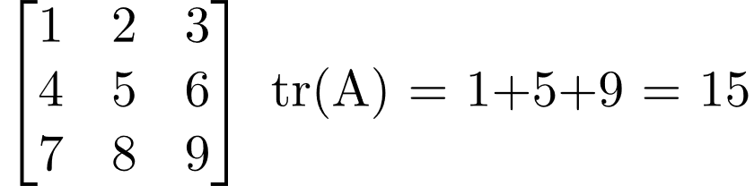
Trace of a matrix: trace of a matrix is denoted as tr(A) which is used only for square matrix and equals the sum of the diagonal elements of the matrix.
For example:

Slide 11
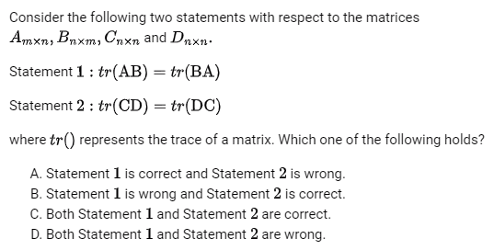
GATE CS 2022
Answer: (C)

Slide 12
Determinants

Slide 13
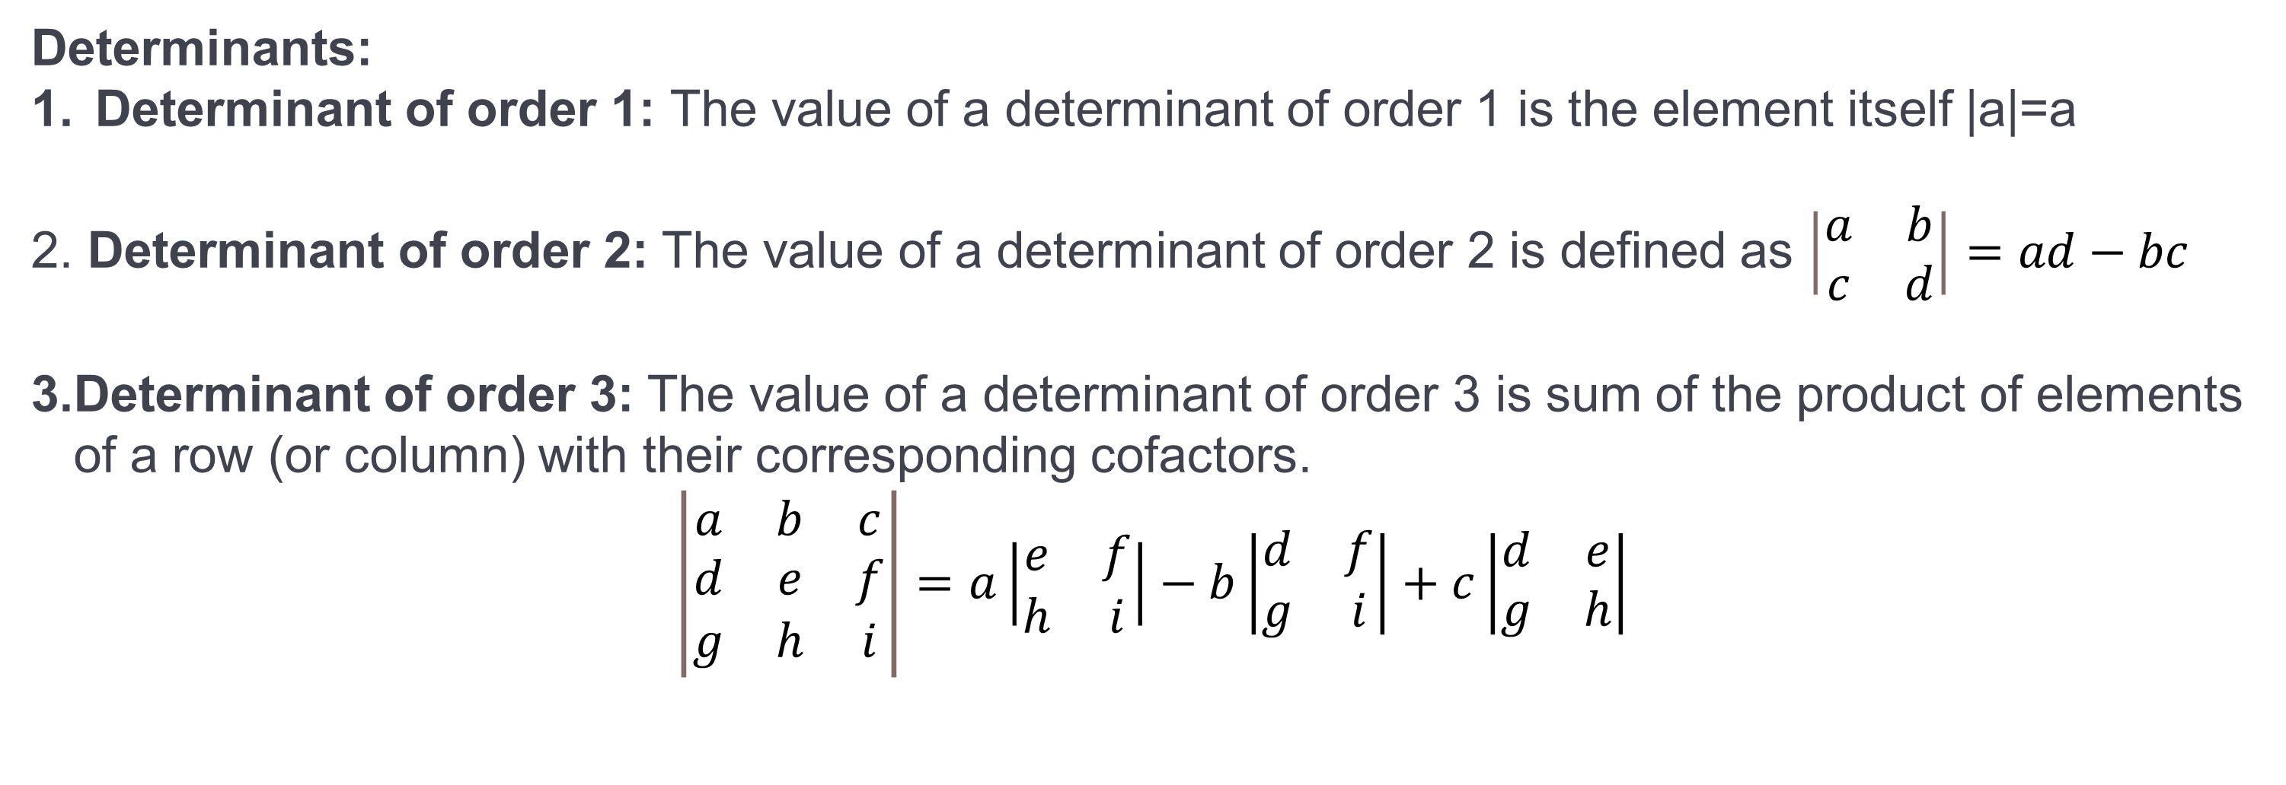
Determinants:
Determinant of order 1: The value of a determinant of order 1 is the element itself |a|=a
Determinant of order 2: The value of a determinant of order 2 is defined as $\left|\begin{matrix}a & b \\ c & d\end{matrix}\right|=ad−bc$
Determinant of order 3: The value of a determinant of order 3 is sum of the product of elements of a row (or column) with their corresponding cofactors.
$$\left|\begin{matrix}a & b & c \\ d & e & f \\ g & h & i\end{matrix}\right|=a\left|\begin{matrix}e & f \\ h & i\end{matrix}\right|−b\left|\begin{matrix}d & f \\ g & i\end{matrix}\right|+c\left|\begin{matrix}d & e \\ g & h\end{matrix}\right|$$

Slide 14
Question :If the two matrices $\left[\begin{matrix}1 & 0 & x \\ 0 & x & 1 \\ 0 & 1 & x\end{matrix}\right] and \left[\begin{matrix}x & 1 & 1 \\ x & 0 & 1 \\ 0 & x & 0\end{matrix}\right]$ have the same determinant then what is the value of x is

Slide 15
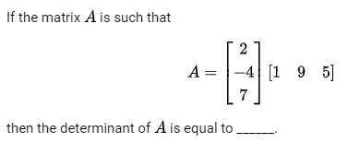
Answer: 0

Slide 16
Singular and Nonsingular Matrix:
Singular Matrix: A square matrix is said to be singular matrix if its determinant is zero i.e. |A|=0
Nonsingular Matrix: A square matrix is said to be non-singular matrix if its determinant is non-zero.

Slide 17
GATE CSE 2019
Let X be a square matrix. Consider the following two statements on X.
X is invertible
Determinant of X is non-zero
Which one of the following is TRUE?
I implies II; II does not imply I
II implies I; I does not imply II
I does not imply II; II does not imply I
I and II are equivalent statements
Answer: (D)

Slide 18
Properties of Determinant of Matrices
Determinant evaluated across any row or column is same.
If all the elements of a row (or column) are zeros, then the value of the determinant is zero.
Determinant of a Identity matrix $I_{n}=1$

Slide 19
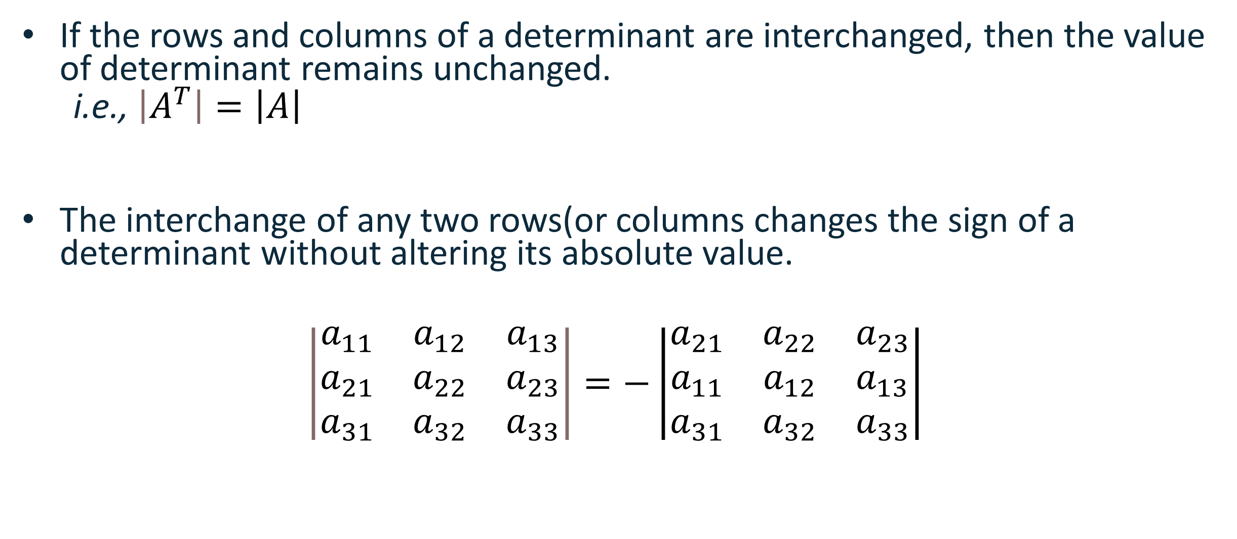
If the rows and columns of a determinant are interchanged, then the value of determinant remains unchanged.
i.e., $\left|A^{T}\right|=\left|A\right|$
The interchange of any two rows(or columns changes the sign of a determinant without altering its absolute value.
$$\left|\begin{matrix}a_{11} & a_{12} & a_{13} \\ a_{21} & a_{22} & a_{23} \\ a_{31} & a_{32} & a_{33}\end{matrix}\right|=−\left|\begin{matrix}a_{21} & a_{22} & a_{23} \\ a_{11} & a_{12} & a_{13} \\ a_{31} & a_{32} & a_{33}\end{matrix}\right|$$

Slide 20
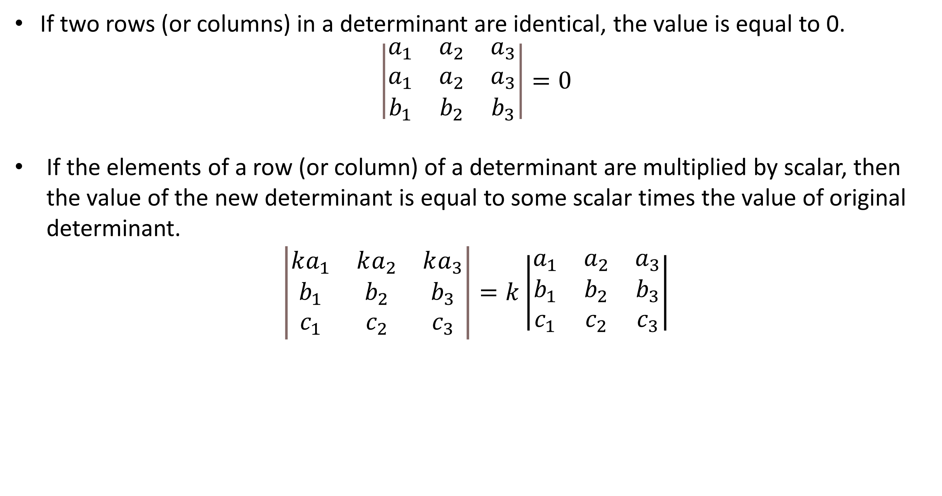
If two rows (or columns) in a determinant are identical, the value is equal to 0.
$$\left|\begin{matrix}a_{1} & a_{2} & a_{3} \\ a_{1} & a_{2} & a_{3} \\ b_{1} & b_{2} & b_{3}\end{matrix}\right|=0$$
If the elements of a row (or column) of a determinant are multiplied by scalar, then the value of the new determinant is equal to some scalar times the value of original determinant.
$$\left|\begin{matrix}ka_{1} & ka_{2} & ka_{3} \\ b_{1} & b_{2} & b_{3} \\ c_{1} & c_{2} & c_{3}\end{matrix}\right|=k\left|\begin{matrix}a_{1} & a_{2} & a_{3} \\ b_{1} & b_{2} & b_{3} \\ c_{1} & c_{2} & c_{3}\end{matrix}\right|$$

Slide 21
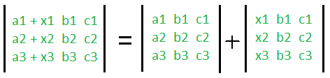
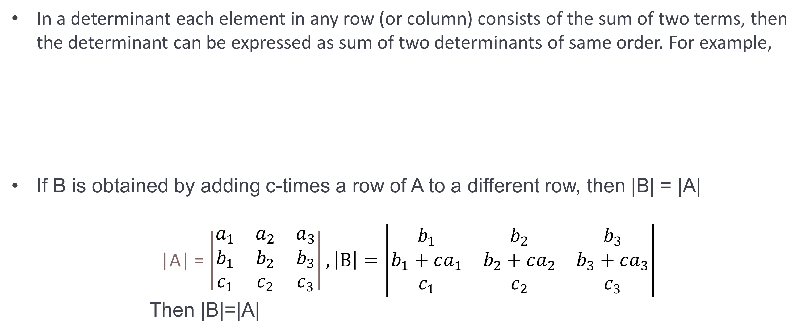
In a determinant each element in any row (or column) consists of the sum of two terms, then the determinant can be expressed as sum of two determinants of same order. For example,
If B is obtained by adding c-times a row of A to a different row, then |B| = |A|
|A| = $\left|\begin{matrix}a_{1} & a_{2} & a_{3} \\ b_{1} & b_{2} & b_{3} \\ c_{1} & c_{2} & c_{3}\end{matrix}\right|, \left|B\right|=\left|\begin{matrix}b_{1} & b_{2} & b_{3} \\ b_{1}+ca_{1} & b_{2}+ca_{2} & b_{3}+ca_{3} \\ c_{1} & c_{2} & c_{3}\end{matrix}\right|$
Then |B|=|A|

Slide 22
Determinant of diagonal matrix, triangular matrix (upper triangular or lower triangular matrix) is product of element of the principal diagonal.
Determinant of Inverse of matrix can be defined as |$A^{−1}|=\frac{1}{\left|A\right|}$
If A is an $n×n$matrix then $\left|kA\right|=k^{n}\left|A\right|$

Slide 23

GATE-CS-2000
Question: The determinant of the matrix is

Slide 24
A square matrix is singular whenever
The rows are linearly independent
The columns are linearly independent
The row are linearly dependent
None of the above
Answer: (C)

Slide 25
GATE-CS-2015
Perform the following operations on the matrix
$$\left[\begin{matrix}3 & 4 & 45 \\ 7 & 8 & 105 \\ 13 & 2 & 195\end{matrix}\right]$$
Add the third row to the second row.
Subtract the third column from the first column.
The determinant of the resultant matrix is _____________. (A) 0 (B) 1 (C) 50 (D) 100

Slide 26
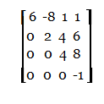
GATE CS 1997
The determinant of the matrix is
(A) 11 (B) -48 (C) 0 (D) -24

Slide 27

GATE CS 1998
Which of the following is a factor of Δ ? (A) a+b (B) a-b (C) a+b+c (D) abc
Solution:

Slide 28
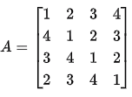
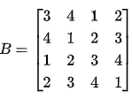
GATE CS 2023
Let
Let det(A) and det(B) denote the determinants of the matrices A and B, respectively.
Which one of the options given below is TRUE?
det(A)=det(B)
det(A)=−det(B)
det(A)=0
det(AB)=det(A)+det(B)
Answer: (B)

Slide 29
Rank of a matrix

Slide 30
Elementary Transformations
Interchange of any two rows or columns $R_{i}↔R_{j}$ or $C_{i}↔C_{j}$
Multiplication of the ith row (or the ith column) by a non-zero number k
$R_{i}↔kR_{i}$ or $C_{i}↔kC_{i}$.
Addition of k times the jth row (or column) to the ith row (or column).
$R_{i}↔R_{i}+kR_{j}$ or $C_{i}↔C_{i}+kC_{j}$

Slide 31
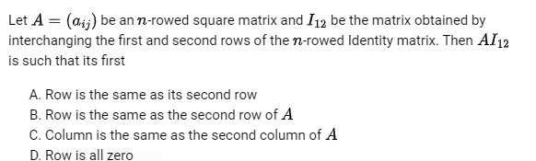
GATE CSE 1997

Slide 32
Row- Reduced Echelon Form
A matrix is said to be row-reduced echelon form if
The non-zero rows occur above the zero rows, if any
The number of zeros preceding the first non-zero element in a row is greater than the number of such zeros in preceding row.
Example: $\begin{matrix} \\ \left[\begin{matrix}0 & 1 & 1 & 0 & 1 \\ 0 & 0 & 0 & 1 & 0 \\ 0 & 0 & 0 & 0 & 0\end{matrix}\right] and \left[\begin{matrix}1 & 0 & 3 & 0 \\ 0 & 1 & 1 & 0 \\ 0 & 0 & 0 & 0\end{matrix}\right]\end{matrix}$ are in the row- reduced echelon form.
But $\left[\begin{matrix}0 & 0 & 0 \\ 1 & 1 & 0 \\ 0 & 0 & 1\end{matrix}\right]$ is not

Slide 33


Slide 34
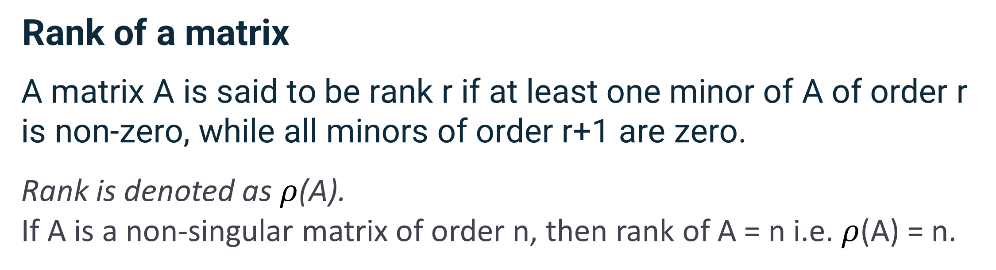

Slide 35
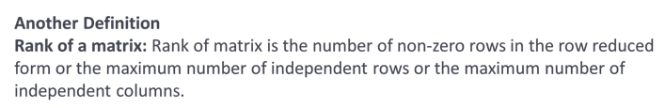

Slide 36


Slide 37
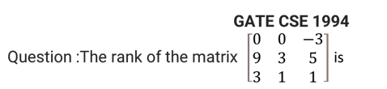

Slide 38
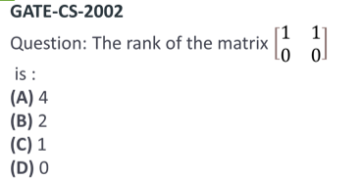

Slide 39

What could be the possible values of rank(A) as “a" varies:
For some value of a, rank could be 0
For some value of a, rank could be 1
For some value of a, rank could be 2
For some value of a, rank could be 3

Slide 40
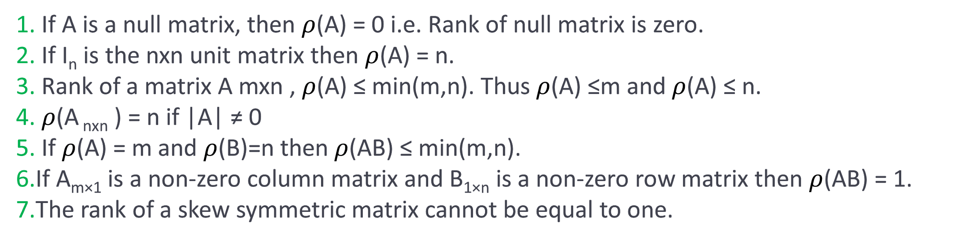

Properties of rank of a matrix:
8.

Slide 41
Let A be a 4×3 real matrix with rank 2. Let B be transpose matrix of A. Which one of the following statement is TRUE? (a) Rank of BA is less than 2. (b) Rank of BA is equal to 2. (c) Rank of BA is greater than 2. (d) Rank of BA can be any number between 1 and 3
Answer: (B)

Slide 42
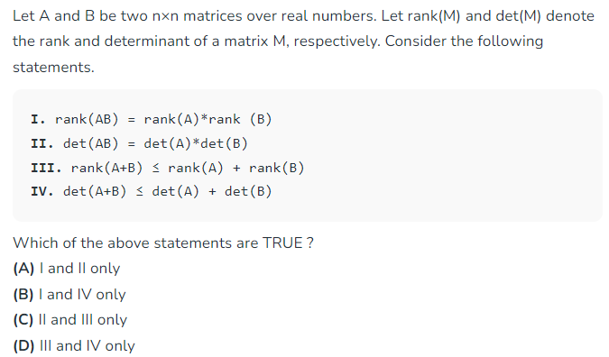

Slide 43
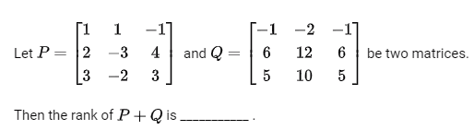
GATE CS 2017

Slide 44
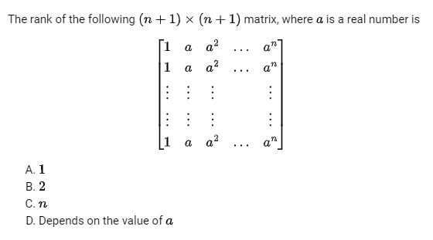
GATE CS 1995

Slide 45
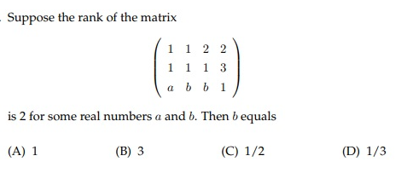

Slide 46

Thank you

